Slide 1

Let’s start with Allah Yaar
Bs in Computer Science

Slide 2
Introduction to Input and Output Devices
Input Devices: Hardware that allows users to send data to a computer. Used to control the computer, enter text, upload images, etc.
Output Devices: Hardware that enables the computer to communicate data back to the user in a readable form, such as visual, audio, or physical formats.
Importance of I/O Devices: Vital for human-computer interaction, providing the bridge between the digital and physical worlds.

Slide 3
Input Devices
Definition: Input devices capture information and send it to the computer for processing.
Examples: Keyboard, mouse, scanners, etc.

Slide 4
Input Devices - Keyboard and Numeric Keypad
Keyboard
Used for typing and command input.
Consists of alphanumeric, function, and control keys.
Common types: Mechanical, membrane, and ergonomic keyboards.
Numeric Keypad
Used primarily for numerical data entry, such as in ATMs, calculators, and point-of-sale systems.
Compact layout (0-9 numbers) with function keys (Enter, Clear).

Slide 5
Input Devices - Pointing Devices and Remote Control
Pointing Devices
Mouse: A handheld device used to control the cursor on a screen.
Trackpad: A flat surface sensitive to finger movements, commonly found on laptops.
Stylus: Pen-like device used on touchscreens for drawing or handwriting.
Remote Control
Wireless device to control TVs, projectors, or computers.
Often uses infrared signals; newer versions may use Bluetooth.

Slide 6
Input Devices - Joystick/Driving Wheel, Touch Screen (as Input)
Joystick: Primarily used for gaming and simulations; controls direction in digital environments.
Driving Wheel: Simulates the steering wheel, typically used in car simulation games.
Touch Screen
Acts as both input and output.
Detects touch gestures (tap, swipe) to control apps and interfaces.
Common in smartphones, tablets.

Slide 7
Input Devises - Scanners, Camera, Microphone, Sensors
Scanners
Convert physical documents into digital form.
Types include flatbed scanners, sheet-fed scanners, and handheld scanners.
Camera
Captures images and videos.
Applications in video conferencing, security, and digital content creation.

Slide 8
Input Devises - Scanners, Camera, Microphone, Sensors
Microphone
Captures audio input for voice commands, recording, and live communication.
Sensors
Detect environmental data such as temperature, motion, and light.
Common in IoT devices for home automation, health monitoring, etc.

Slide 9
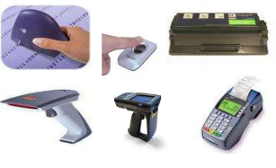
Direct Data Entry Devices
Devices that capture data directly without intermediate input methods, often reducing human error.

Slide 10
Direct Data Entry Devices - Magnetic Stripe Reader and Chip & PIN Reader
Magnetic Stripe Reader
Reads information encoded in magnetic stripes on cards.
Common in payment systems, hotel room keys.
Chip and PIN Reader
Reads chips embedded in modern cards.
Requires PIN for secure transactions, adding an extra layer of security.

Slide 11
Direct Data Entry Devices - RFID Reader, OMR, OCR
RFID Reader
Reads data from RFID tags via radio waves.
Used for asset tracking, inventory management, access control.
Optical Mark Recognition (OMR)
Detects marked areas on forms, like multiple-choice answers.
Often used in exams, surveys, and lotteries.

Slide 12
Direct Data Entry Devices - Bar Code Reader and QR Scanner
Bar Code Reader
Reads black-and-white bar codes on products.
Speeds up product identification in retail and inventory management.
QR Scanner
Reads quick response (QR) codes.
Common for links to websites, digital payments, event tickets.

Slide 13
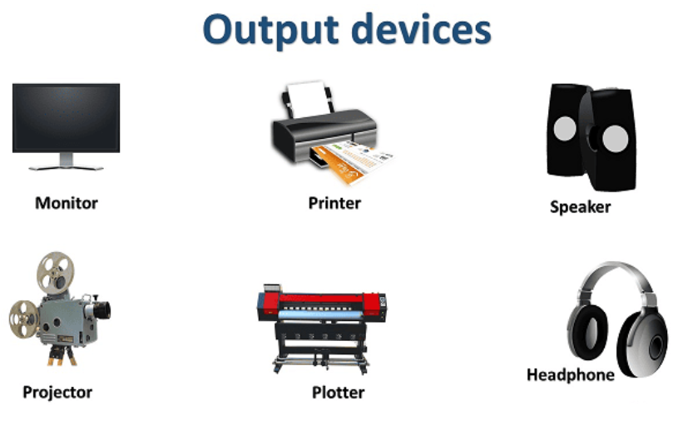
Output Devices
Output devices display, project, or produce the results of computer processing.

Slide 14
Monitors and Touch Screen
Monitors
Displays visual output in real-time.
Types include LCD, LED, OLED, and CRT (older technology).
Touch Screen
Dual-purpose: as both an input and output device.
Displays visual information and allows for interactive touch control.

Slide 15
Multimedia Projector and Printers
Multimedia Projector
Projects computer display onto a large screen for presentations.
Used in classrooms, meetings, and home theaters.
Printers
Laser Printer: High-speed printing, ideal for text-heavy documents.
Inkjet Printer: Suitable for vibrant color images, widely used in homes and offices.

Slide 16
Multimedia Projector and Printers
Dot Matrix Printer: Impact printing; used for multipart forms.
Plotter: Produces large, precise graphics, commonly used in CAD.

Slide 17
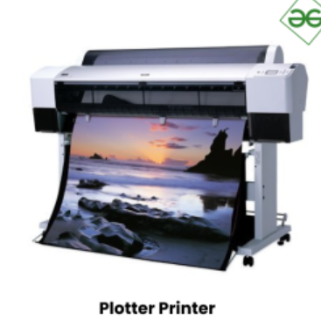
Multimedia Projector and Printers
Dot Matrix Printer: Impact printing; used for multipart forms.
Plotter: Produces large, precise graphics, commonly used in CAD.

Slide 18
3D Printer, Speaker, and Actuator
3D Printer
Builds three-dimensional objects layer by layer.
Applications in prototyping, medical implants, and manufacturing.
Speaker
Converts digital signals to sound.
Used in multimedia presentations, communication, and entertainment.

Slide 19
3D Printer, Speaker, and Actuator
Actuator
Converts electronic signals into physical movements.
Commonly used in robotics, automation, and mechanical processes.

Slide 20
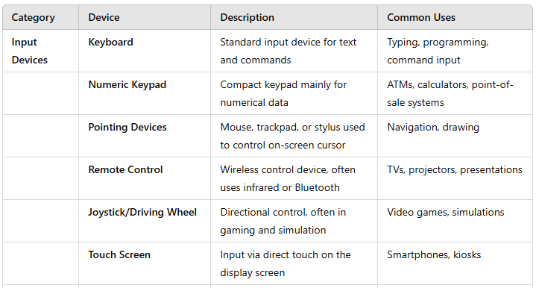
Summary Table

Slide 21
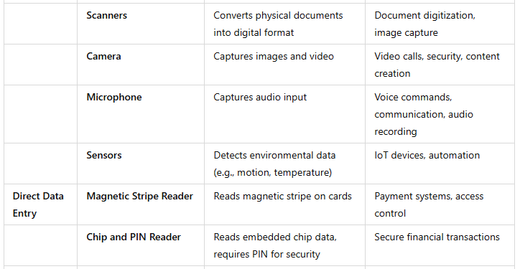
Summary Table

Slide 22
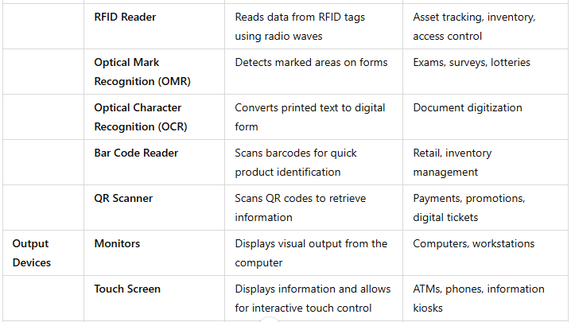
Summary Table

Slide 23
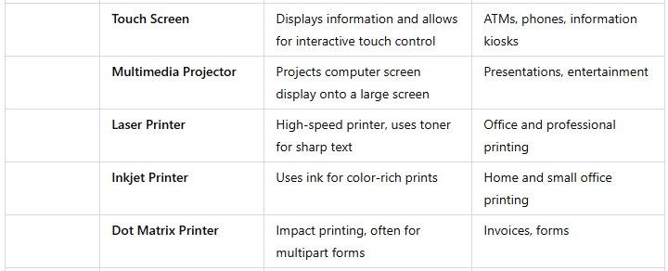
Summary Table

Slide 24
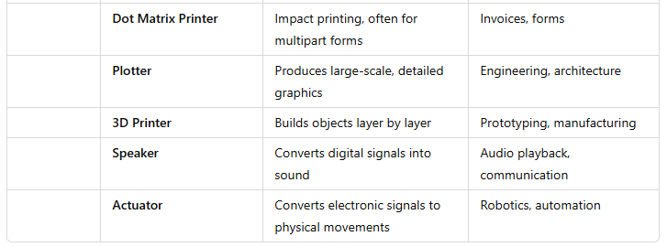
Summary Table

